Slide 1
Deployment using fabric-cicd

Slide 2
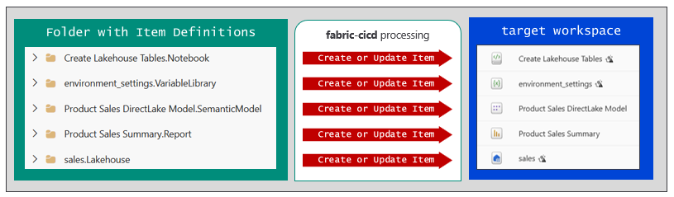
The fabric-cicd Python Library
fabric-cicd library provide wrapper on Fabric REST APIs
Provides reusable library of code for implementing a release process
Deploys from folder of item definitions to set of items in target workspace
Built-in code handles all Fabric REST API programming

Slide 3
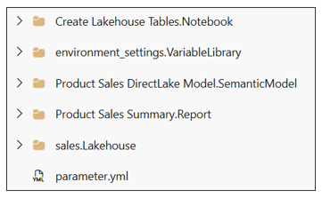
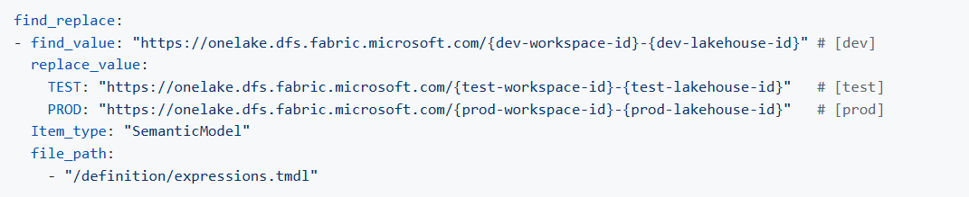

Parameterization with fabric-cicd
Parameterization allows updates to item definition files on the fly
Parameterization required to deal with environment-specific settings committed to GIT
Parameterization enabled by adding parameter.yml file to root folder
Parameterization used to update item definition files using substitution patterns (e.g. find-replace)

Slide 4
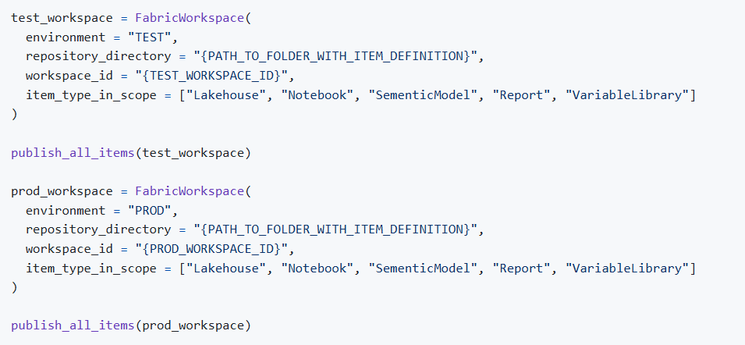
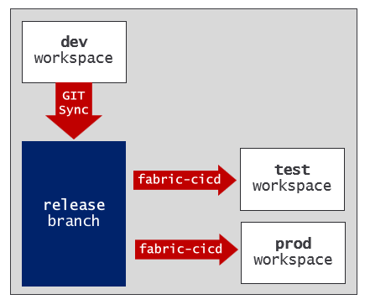
Python Code for fabric-cicd Deployment
Create FabricWorkspace object and call publish_all_items - that's it!
fabric-cicd provides flexibility of one-to-many between GIT branch and workspaces

Slide 5
